Slide 1



CONTRACT TRAINING APPLICATIONS
SEN4013 - Sofware Verification and Validation Project
Yousef El-Bayoumi - 1722326, Sercan Emre Seviniş - 1728942, İpek Yasin - 1503913, Hikmet Çağatay Yılmaz - 1728860,
Ghaıth Nakawah - 1720507

Slide 2
INTRODUCTION
01
APPLICATIONS
02
TABLE OF CONTENTS
TESTING APPROACHES
03
CONCLUSION
04
RESOURCES
05
Croatia,
Spain,
Switzerland
JUnit Testing,
Security Testing,
Performance Testing,
UI Testing,
Code Coverage Testing,
Mutation Testing,
Acceptance Testing

Slide 3
01
INTRODUCTION

Slide 4
SUMMARY
Applications:
Croatia, Spain, Switzerland
Test approaches:
Acceptance Testing, Code Coverage Testing, Performance Testing, Security Testing, Mutation Testing, UI and Junit Testing.
Tools:
Emma(v.11.0), JaCoCo, Unit Test History Coverage, Android 3.0 Profiler, Pitest(v.1.4.4), JMeter, Kit etc.

Slide 5
02
APPLICATIONS

Slide 6

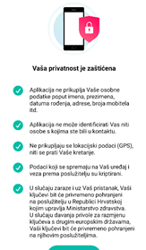
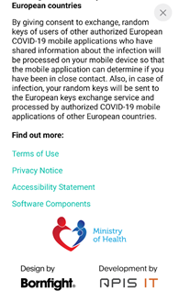
1- CROATIA (STOP COVID-19)
100% Java language written.

Slide 7

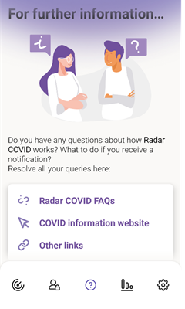
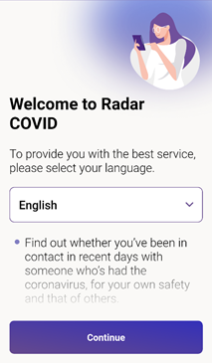
2- SPAIN (RADAR COVID)
Android sdk ----> 100% Kotlin Language
Backend-verification,configuration,server -----> Java Language
Notes:
In Switzerland and Spain Project, developers had already written jUnit test cases. They used the most common technique of jUnit which is assertions. As a general security protection, the app provides minimum information of user in the main servers. Authorities reach information only when user calls them. Users who have not reported positive detections can not be tracked. Furthermore, app will destroy itself after the epidemic ends. Data in the server will be removed after 14 days as a protection for abuse of data. One of the most important protections of the app is avoiding location tracking all the time through broadcast identifiers via usage of “ephemeral identifier(EphID)”. Devices generate EphIDs computed via a seed which is hash function. During the day, phones generate new EphIDs frequently to not to be tracked by the devices they broadcast.

Slide 8
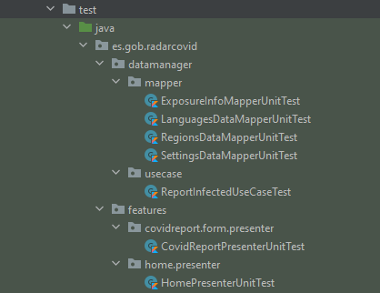
JUNIT TEST CASE CLASSES
There are seven junit test classes in Spain application end with ‘UnitTest’.

Slide 9
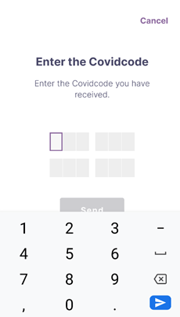


3- SWITZERLAND (SWISSCOVID APPLICATION)
67.8% Java, 31.7% HTML, 0.5% other language written.
Notes:
In Switzerland and Spain Project, developers had already written jUnit test cases. They used the most common technique of jUnit which is assertions. As a general security protection, the app provides minimum information of user in the main servers. Authorities reach information only when user calls them. Users who have not reported positive detections can not be tracked. Furthermore, app will destroy itself after the epidemic ends. Data in the server will be removed after 14 days as a protection for abuse of data. One of the most important protections of the app is avoiding location tracking all the time through broadcast identifiers via usage of “ephemeral identifier(EphID)”. Devices generate EphIDs computed via a seed which is hash function. During the day, phones generate new EphIDs frequently to not to be tracked by the devices they broadcast.

Slide 10
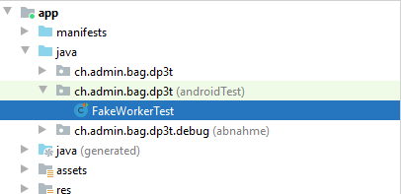
JUNIT TEST CASE CLASSES
There is one junit test class in Switzerland application and 7 methods are tested in the class.

Slide 11
03
TESTING APPROACHES

Slide 12
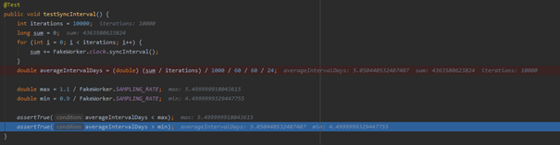
1- JUNIT-Integration TESTING
In figure 1.0, if average interval days which is computed by some operations shown in figure is smaller than max day and bigger than min day, assertTrue method passes without error.
JUnit tests with assertions
Mocking the class: since test methods should reach to different classes, different methods, databases, APIs directly; to eliminate this dependencies, there is fake object (mocking) concept.

Slide 13
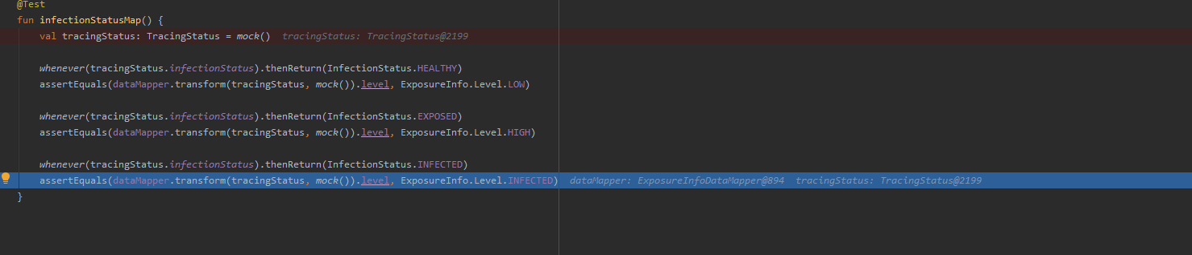
JUnit Testing
In Figure 2.1, “assert equals” methods are generated to test if low, high and infected level of exposures are working or not. If mock object status are equal to real object status, test passes.
Notes:
If this test had connections to related classes or databases and therefore considered modules together and tested them, it should have transformed to integration test since tracingStatus class has dependencies on APIs and server. However with this code, the thing tried to be shown is if the method is working by itself or not.

Slide 14
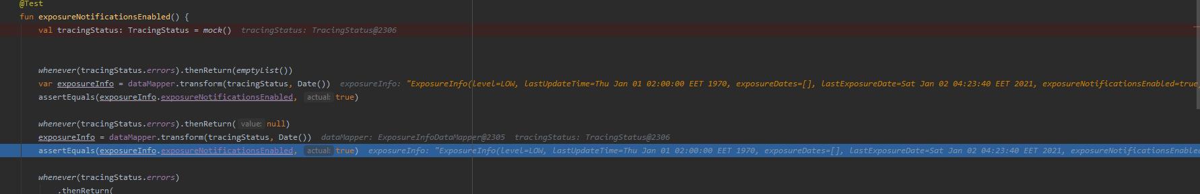
JUnit Testing
In Junit tests, since test methods should reach to different classes, different methods, databases, APIs directly; to eliminate this dependencies, there is fake object (mocking) concept. Again, this test method is executed between “@before” and “@after” notated methods.Here, from assertion methods, assertEquals is used to check given parameters are equal to each other or not.Mock class returns a fake object from “TracingStatus” class and “ExposureInfoData-Mapper”.Because exposureNotificationEnabled attribute is True, test is succeeded.

Slide 15
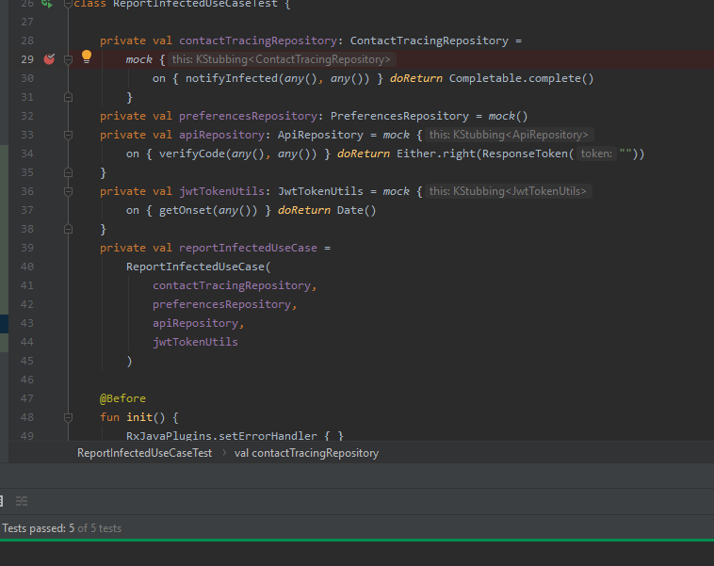
JUnit Testing
JUnit test with Assertions

Slide 16
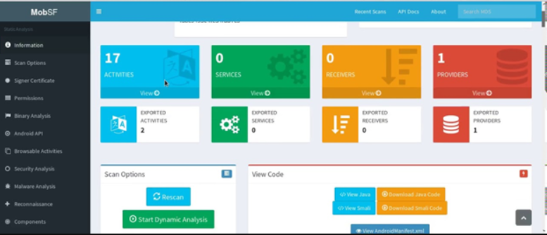
2- SECURITY TESTING
Quick Android Review Kit (QARK): Automated test for several security vulnerabilities, unsuccessful. 😕
MobSF (Mobile Security Framework): For both static and dynamic analysis, also penetration testing. Partially successful. 😐

Slide 17
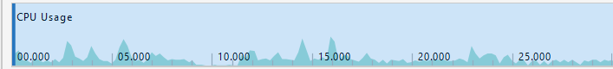
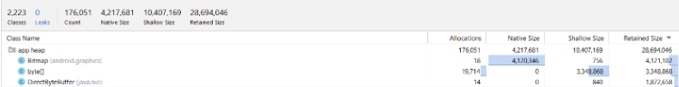
3- PERFORMANCE TESTING
JMeter: Good for stress testing, load testing et cetera.
Problem: Could not figured out how to listen same port with emulator.
Android Profiler: For monitoring CPU, memory, network and energy.
Trace Type:Sampled(Sampling Rate: 1000µs)
CPU Profiler and Memory Profiler samples

Slide 18

4- UI TESTING
60% of the user very unlikely to use application with UI/UX problem ("What 1000 Consumers Say About Bad Customer Service", 2021)
Espresso, with UI Automator. 🙂
ViewInteraction textView = onView(
allOf(withText("Zurich"),
childAtPosition(
allOf(withId(R.id.where_to_test_links_container),
childAtPosition(
withClassName(is("android.widget.LinearLayout")),
1)),
5)));
textView.perform(scrollTo(), click());

Slide 19
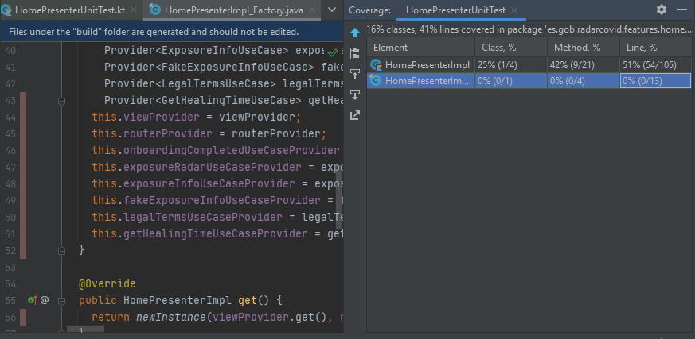
5- CODE COVERAGE TESTING
Emma(v.11.0), JaCoCo, Unit Test History Coverage,, Code Coverage History(plugin).
Determines the number of code lines that is successfully validated
Easy maintenance of code base
Exposure of bad code
Code coverage testing for HomePresenterUnitTest class using Code coverage History for Spain application.

Slide 20
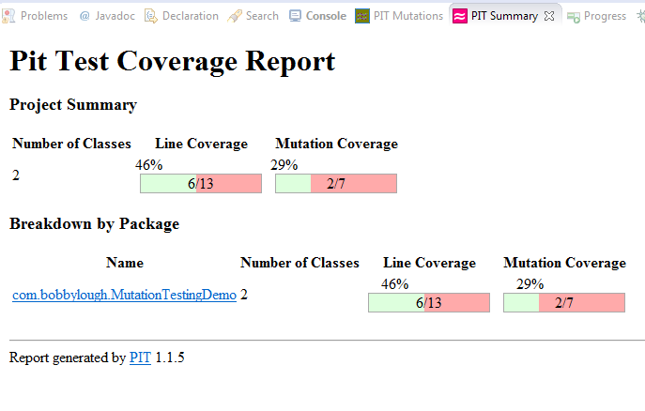
6- MUTATION TESTING
Using Pitest
Find errors in the source code
Ensure the quality of the test cases in terms of robustness

Slide 21

7- ACCEPTANCE TESTING
More closer to use-cases
System is tested for acceptability
Evaluating the system’s compliance

Slide 22
04
CONCLUSION

Slide 23
SUMMARY
Applications:
Got some errors when we tried to import applications.
Test approaches:
Used Android Studİo & IntelliJ IDEA.
Tools:
Got some errors when we tried to plug tools.

Slide 24
05
RESOURCES

Slide 25
REFERENCES
https://plugins.jetbrains.com/plugin/103-emma-code-coverage/versions
https://medium.com/@tugba/mutation-testingin-faydalar%C4%B1-7ee665ff6ddf
https://hkdemircan.medium.com/mutation-testing-ca6bd4761d32#:~:text=Mutasyon%20Testi%2C%20kaynak%20koddaki%20belirli,etti%C4%9Fimiz%20bir%20t%C3%BCr%20yaz%C4%B1l%C4%B1m%20testidir.&text=Bu%20y%C3%B6ntem%2C%20programda%20bir%20hata,test%20stratejisi%20olarak%20da%20adland%C4%B1r%C4%B1l%C4%B1r.
www.youtube.com
Mobile Security Framework - MobSF Documentation. (2020). Retrieved 18 December 2020, from https://mobsf.github.io/docs/#/
Test apps on Android. (2020) - Android Documentation. Retrieved 30 December 2020, from https://developer.android.com/training/testing/
What 1000 Consumers Say About Bad Customer Service. (2021). Retrieved 1 January 2021, from https://www.kayako.com/blog/bad-customer-service/

Slide 26
THANKS!
Any Question?

